Slide 1
Software Project Lab – I Symbolic Execution
Presented by :
Toukir Ahammed
Roll : BSSE0806.
Supervised by :
Alim Ul Gias
Lecturer, IIT,
University of Dhaka.

Slide 2
Methodology
1. Read the source file
2. Find all basic block
3. Number each basic block
6. Construct a Control Flow Graph
5. Traverse the Control Flow Graph
4. Find all possible paths
7. Find Path Constraint for each path
8. Find a possible solution for each path
9.Output the results

Slide 3
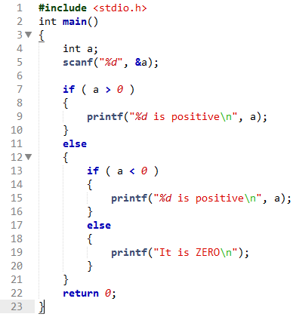
Sample Input

Slide 4
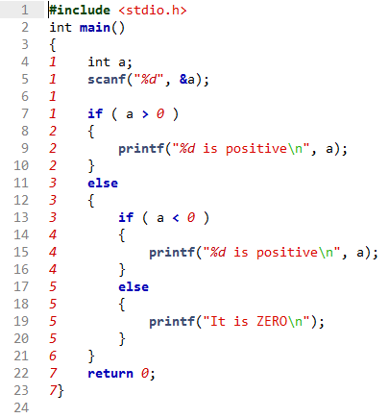
Input File After Numbering Basic Block

Slide 5
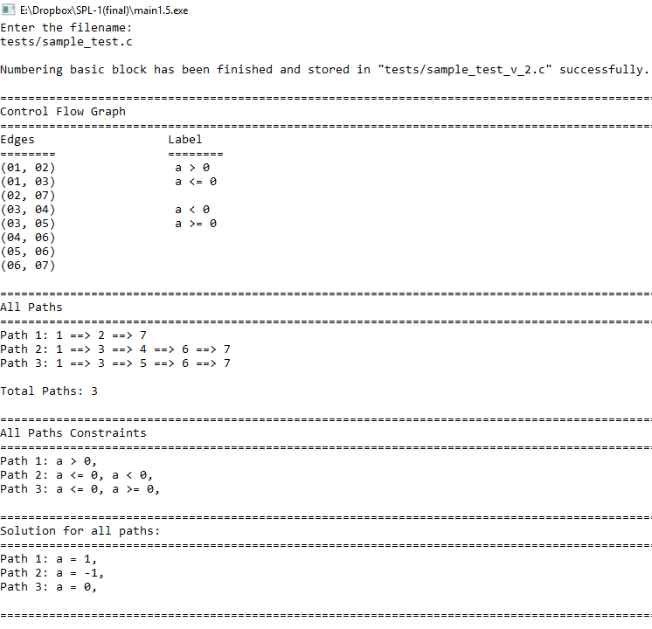
Output

Slide 6
Thank You

